Slide 1
Deep Learning
Yann LeCun, Yoshua Bengio & Geoffrey Hinton
모바일시스템공학과
박찬호
LeCun, Y., Bengio, Y. & Hinton, G. Deep learning. Nature 521, 436–444 (2015).

Slide 2
Contents
Before Getting Stared
Representation Learning
Supervised Learning
Optimizer
Selectivity – Invariance Dilemma
Deep Learning
ConvNet
Distributed Representation
RNN

Slide 3
Before Getting Started
Yann LeCun, Yoshua Bengio, Geoffrey Hinton
Nature
2015

Slide 4
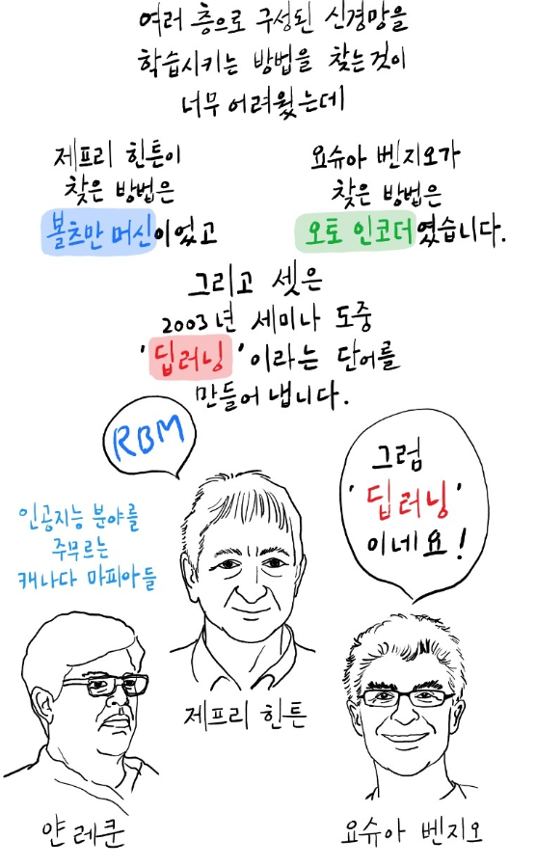
Before Getting Started
Yann LeCun, Yoshua Bengio, Geoffrey Hinton
Nature
2015
https://brunch.co.kr/@hvnpoet/79

Slide 5
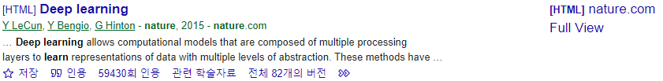
Before Getting Started
Yann LeCun, Yoshua Bengio, Geoffrey Hinton
Nature
2015

Slide 6
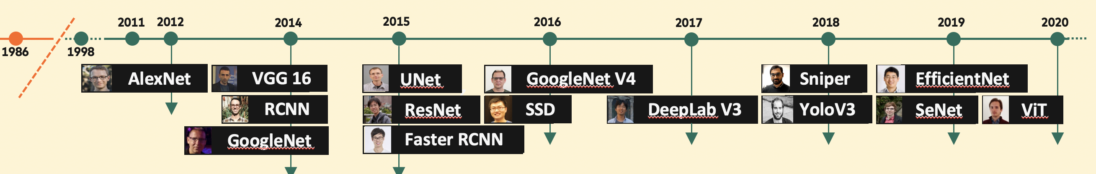
Before Getting Started
Yann LeCun, Yoshua Bengio, Geoffrey Hinton
Nature
2015
https://www.analyticsvidhya.com/blog/2021/08/computer-vision-and-how-it-is-shaping-the-world-around-us/

Slide 7
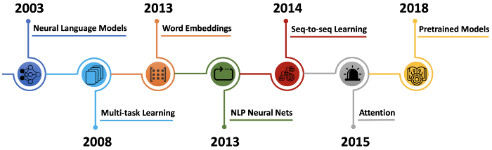
Before Getting Started
Yann LeCun, Yoshua Bengio, Geoffrey Hinton
Nature
2015
https://medium.com/@antoine.louis/a-brief-history-of-natural-language-processing-part-2-f5e575e8e37

Slide 8
Representation Learning
Conventional machine learning
Required engineering & domain knowledge → design feature extractor
limitation
Representation Learning
Fed with raw data → automatically discover representations
Deep Learning

Slide 9
Representation Learning
Deep Learning
Composing layers with non-linear modules
One layer transforming representation at one level
Lower layer : raw input → higher layer : abstract representations
Features not designed by humans with domain knowledge
With raw data
General-purpose learning procedure

Slide 10
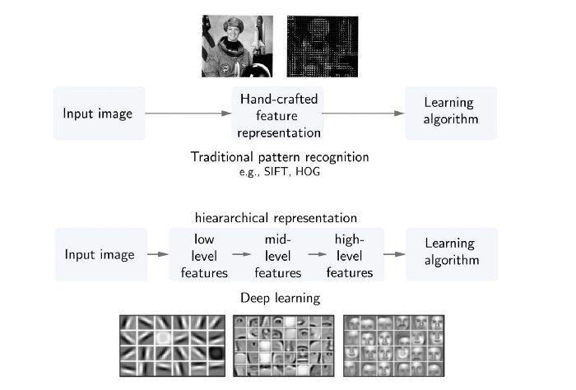
Representation Learning
Deep Learning
Composing layers with non-linear modules
One layer transforming representation at one level
Lower layer : raw input → higher layer : abstract representations
Features not designed by humans with domain knowledge
With raw data
General-purpose learning procedure
https://blog.kthais.com/representation-learning-the-core-of-machine-learning-e25fab0f3ac0

Slide 11
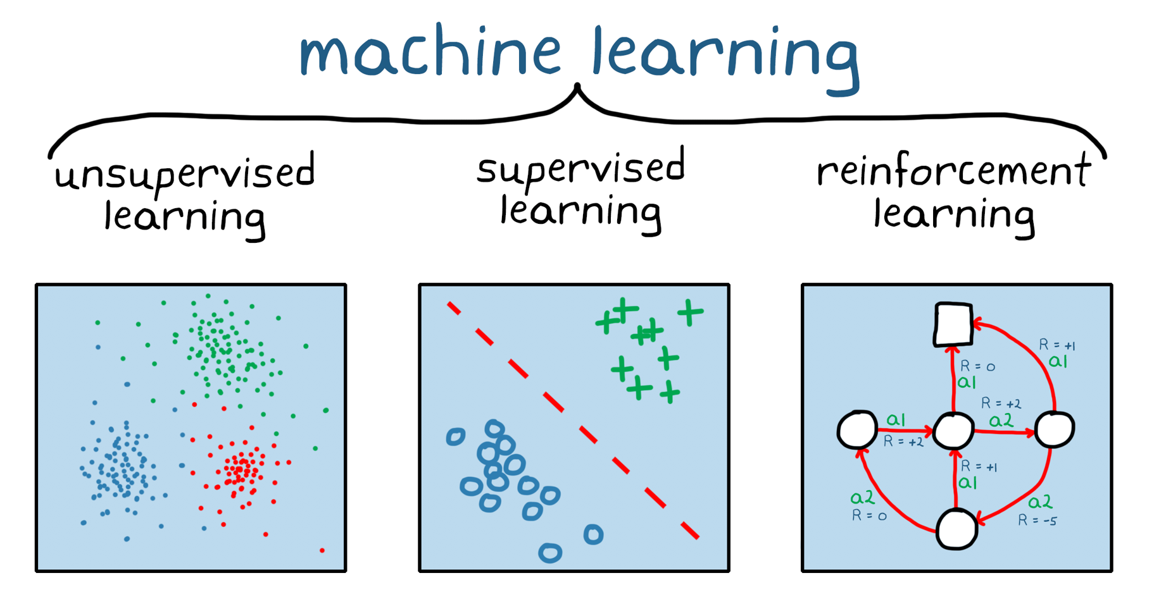
Supervised Learning
Supervised Learning
Train with label
Unsupervised Learning
Train without label
Reinforcement Learning
Agent -> actions
Reward, State, Environment
https://www.mathworks.com/discovery/reinforcement-learning.html

Slide 12
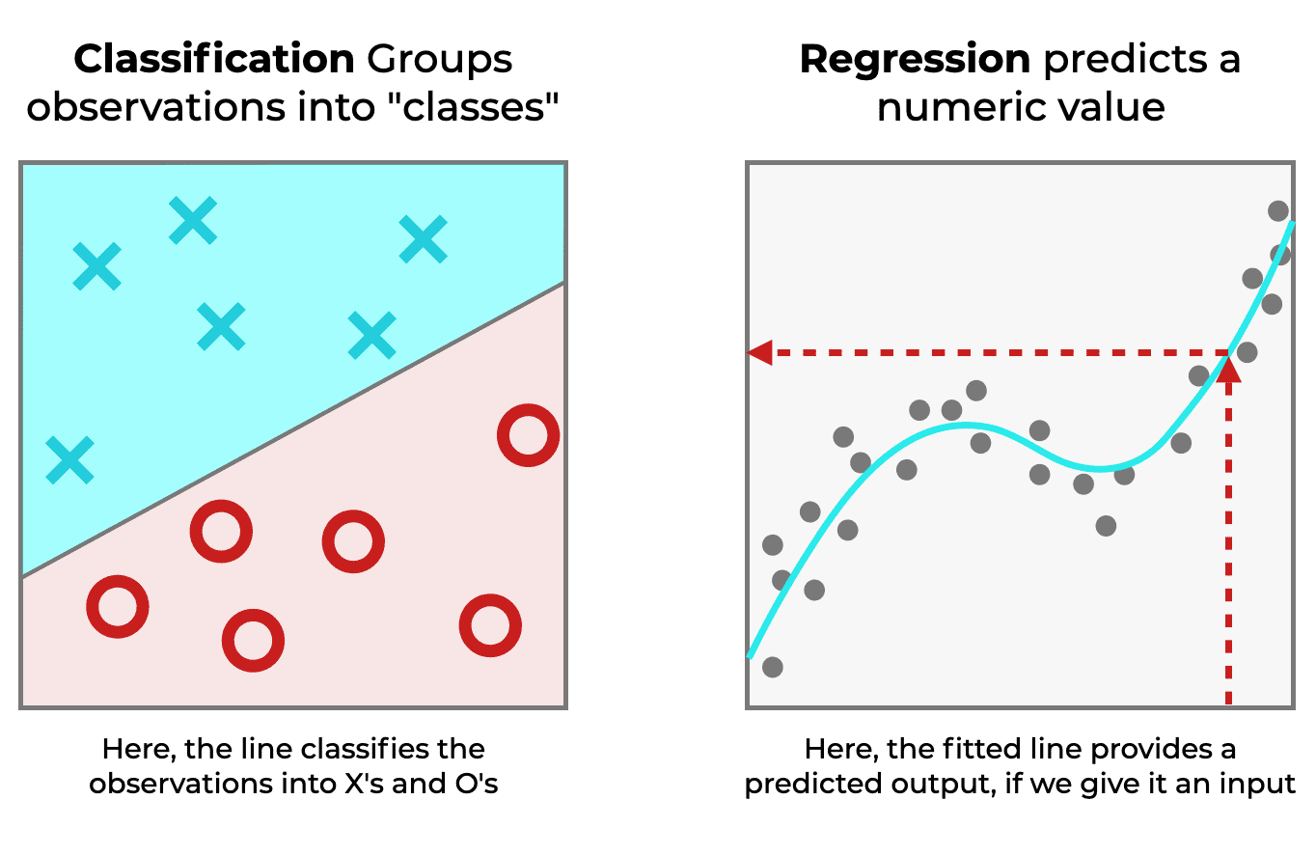
Supervised Learning
Classification
Learning (training) with discrete labels
Categories, classes …
Regression
Learning (training) with continuous labels
Real-valued output
https://www.sharpsightlabs.com/blog/regression-vs-classification/

Slide 13
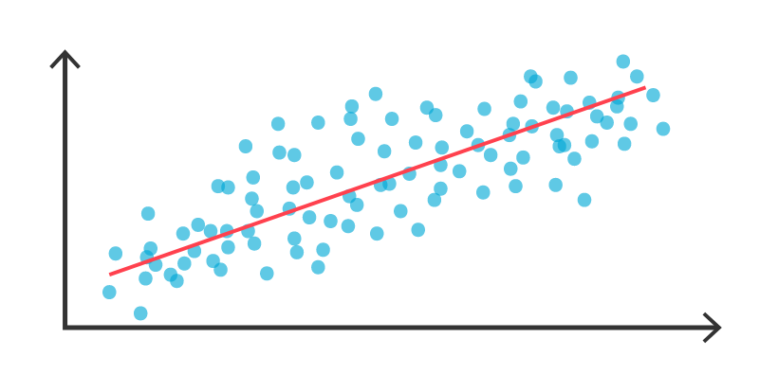
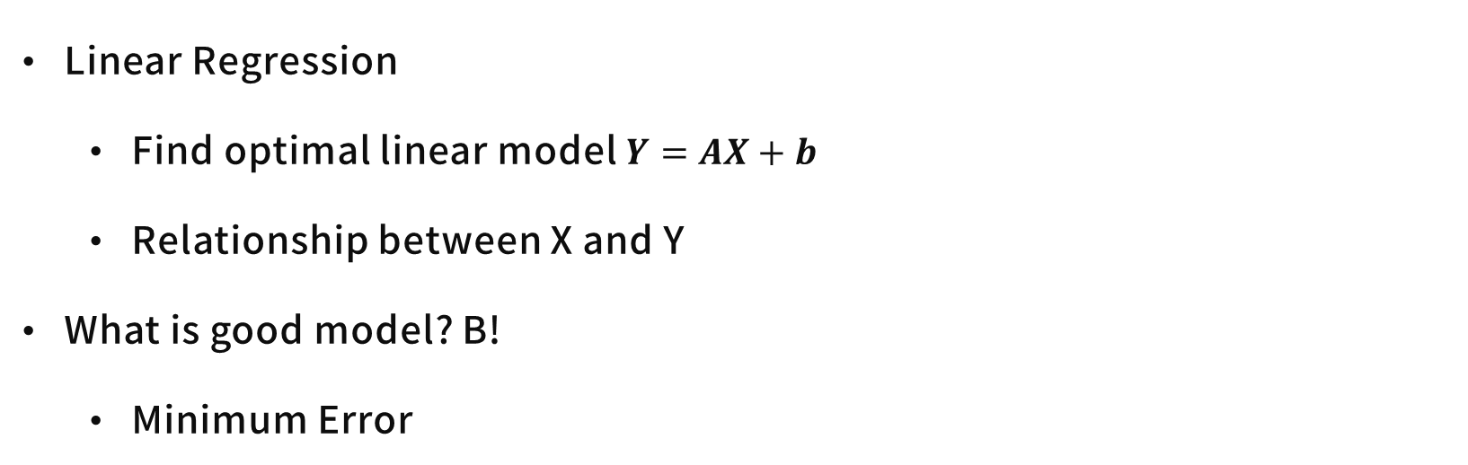
Supervised Learning - Example
Linear Regression
Find optimal linear model $Y=AX+b$
Relationship between X and Y
What is good model? B!
Minimum Error
A
B
C
https://www.tibco.com/ko/reference-center/what-is-regression-analysis

Slide 14
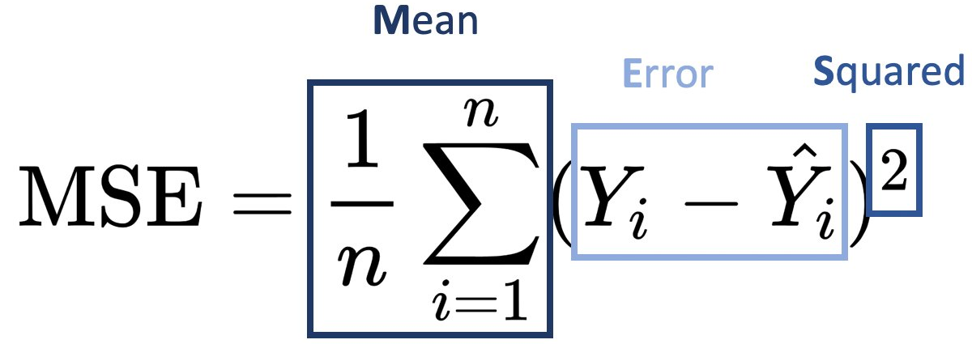
Supervised Learning – Objective Function
Objective Function (= Cost Function)
Compute error (= distance)
Machine modifies internal adjustable parameters to minimize error
Parameters = Weights
Adjust weights by Gradient Descent
https://www.tibco.com/ko/reference-center/what-is-regression-analysis

Slide 15
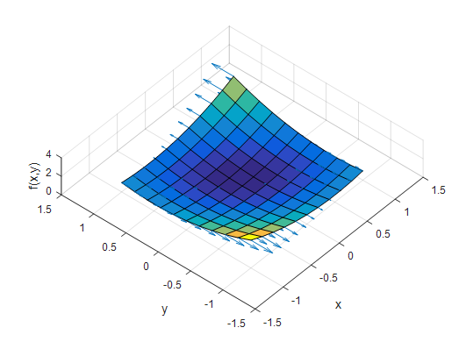
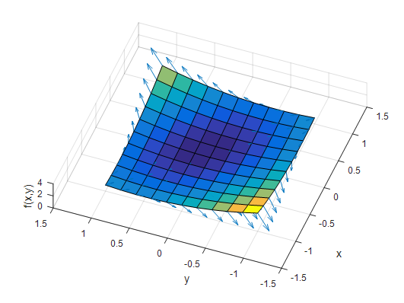
Supervised Learning – Gradient Descent
Gradient
Partial derivative of J with regard to each parameter
Gradient is a vector field

Slide 16
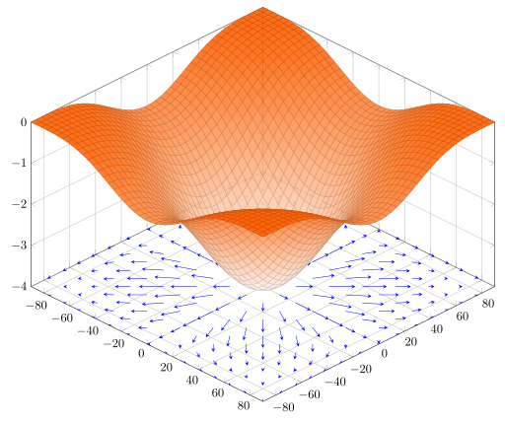
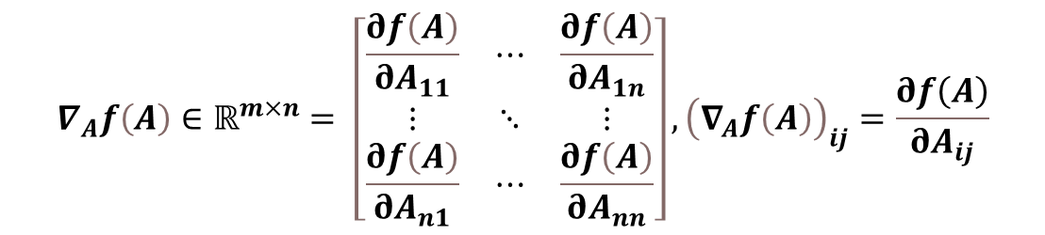
Supervised Learning – Gradient Descent
Gradient
Partial derivative of J with regard to each parameter
Gradient is a vector field
$$∇_{A}f\left(A\right)∈ℝ^{m×n}= \left[\begin{matrix}\frac{∂f\left(A\right)}{∂A_{11}} & ⋯ & \frac{∂f\left(A\right)}{∂A_{1n}} \\ ⋮ & ⋱ & ⋮ \\ \frac{∂f\left(A\right)}{∂A_{n1}} & ⋯ & \frac{∂f\left(A\right)}{∂A_{nn}}\end{matrix}\right], {\left(∇_{A}f\left(A\right)\right)}_{ij}=\frac{∂f\left(A\right)}{∂A_{ij}}$$

Slide 17
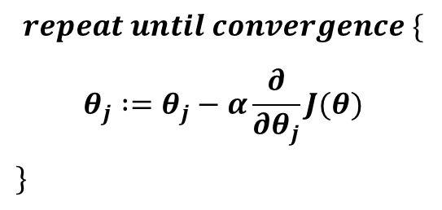
Supervised Learning – Gradient Descent
Gradient Descent
Compute gradient vector for each weight
Adjust weight vector in the opposite direction to gradient vector
$$repeat until convergence \{$$
$$θ_{j} :=θ_{j}−α\frac{∂}{∂θ_{j}}J(θ)$$
$\}$

Slide 18
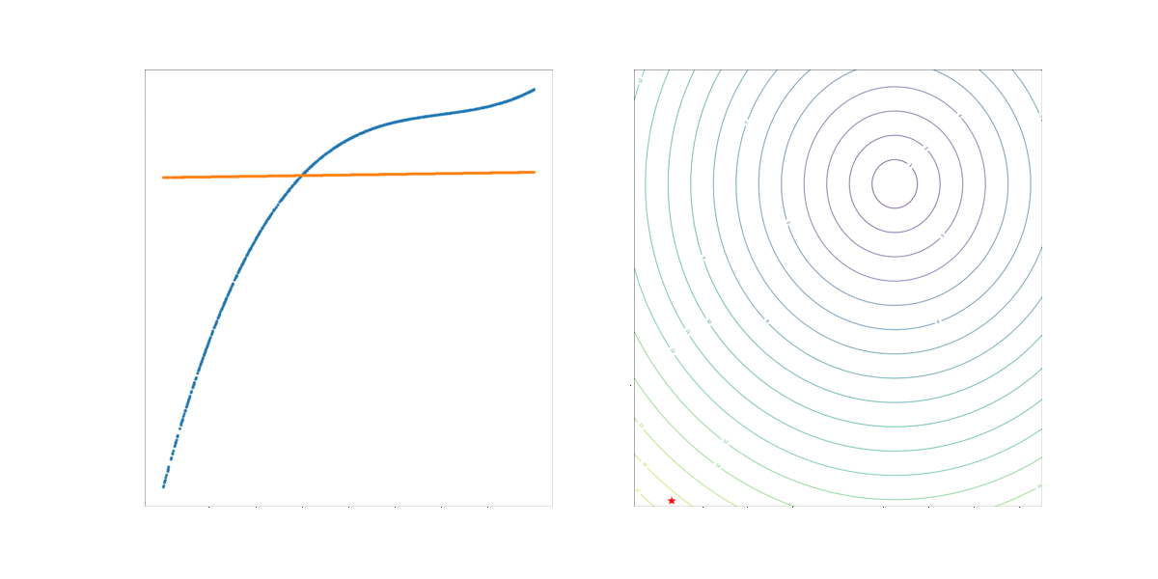

Supervised Learning – Gradient Descent
Gradient Descent
Compute gradient vector for each weight
Adjust weight vector in the opposite direction to gradient vector
https://blog.paperspace.com/intro-to-optimization-in-deep-learning-gradient-descent/

Slide 19
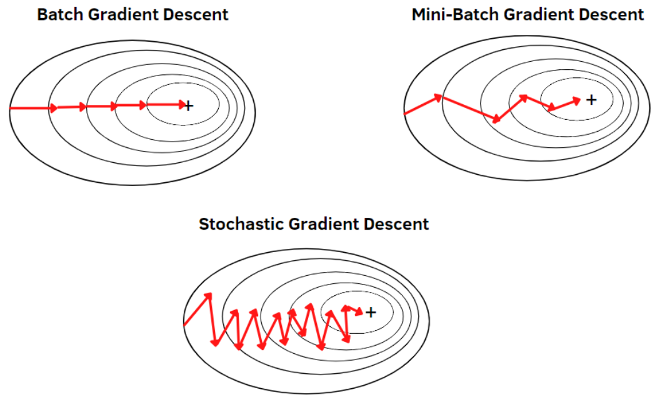
Supervised Learning – Gradient Descent
Stochastic Gradient Descent
Randomly choose a few samples
Stochastic → noisy estimate of the average gradient of samples
https://pub.towardsai.net/understanding-optimization-algorithms-309d8065599d

Slide 20
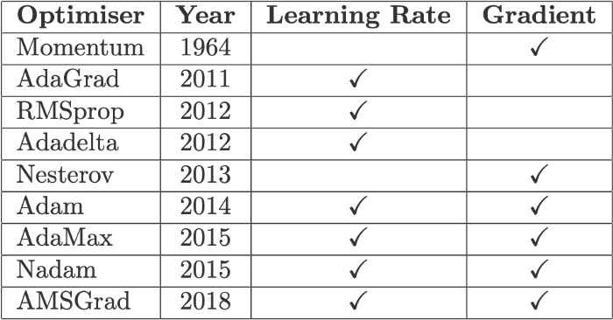
Optimizer?
https://towardsdatascience.com/10-gradient-descent-optimisation-algorithms-86989510b5e9

Slide 21
Optimizer?
Poor local minima
Rarely a problem
Saddle points
Large number of saddle points
Surface curves up in most dimensions and curves down in few

Slide 22

Optimizer?
Poor local minima
Rarely a problem
Saddle points
Large number of saddle points
Surface curves up in most dimensions and curves down in few

Slide 23
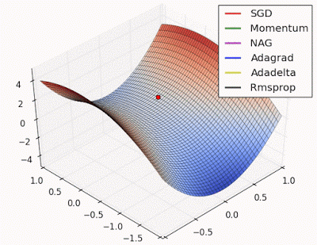
Optimizer?
Optimizers
Rmsprop
Adam
…
https://medium.com/analytics-vidhya/artificial-neural-networks-an-intuitive-approach-part-5-95da50a9cffd

Slide 24
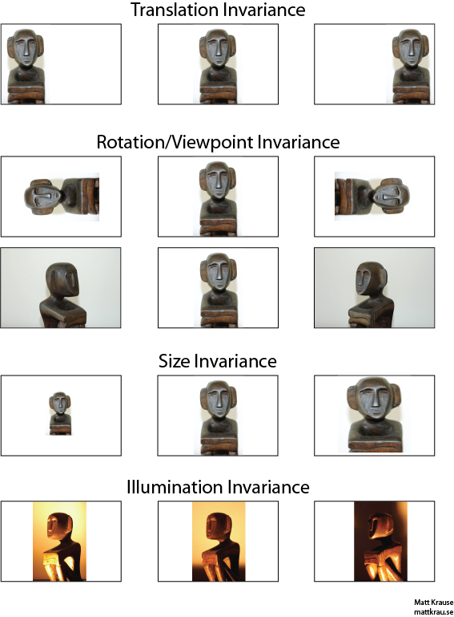
Selectivity – Invariance Dilemma
Selectivity – Invariance Dilemma
Insensitive to irrelevant variations of input
Sensitive to particular minute variations
Linear classifiers or ‘shallow’ classifiers has limitation
Sensitivity ↑ then invariance↓
Example
White wolf and Samoyed
https://stats.stackexchange.com/questions/208936/what-is-translation-invariance-in-computer-vision-and-convolutional-neural-netwo

Slide 25
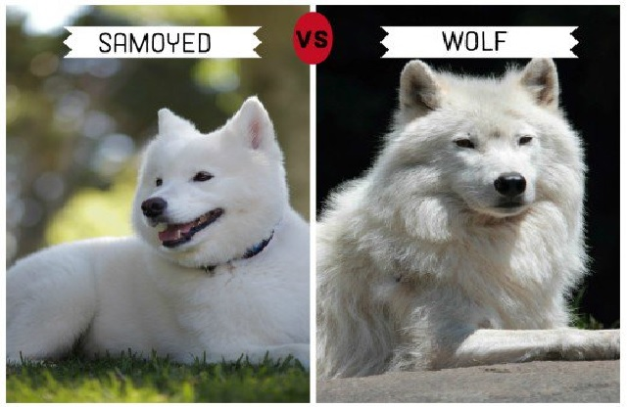
Selectivity – Invariance Dilemma
Selectivity – Invariance Dilemma
Insensitive to irrelevant variations of input
Sensitive to particular minute variations
Linear classifiers or ‘shallow’ classifiers has limitation
Sensitivity ↑ then invariance↓
Example
White wolf and Samoyed
https://tracki.com/blogs/post/11-dogs-that-look-like-wolves

Slide 26
Selectivity – Invariance Dilemma
Linear classifiers or ‘shallow’ classifiers has limitation
Needed good feature extractor
Non-linear activations
Non-linear input-output mapping

Slide 27
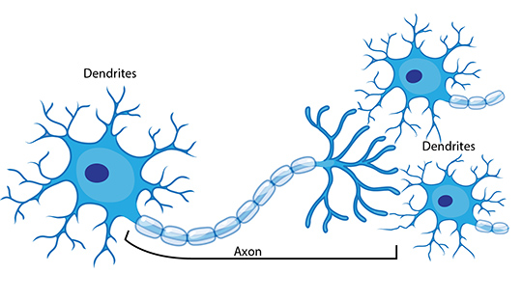
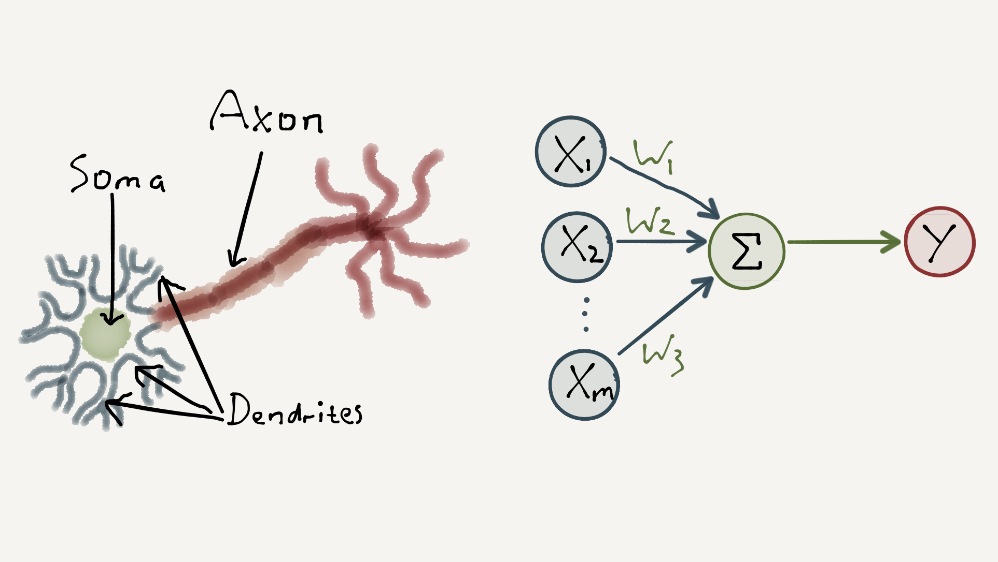
Deep Learning - Perceptron
Neuron
Perceptron motive from Neuron
Aggregate input to make output
Weighted Sum
Activation
Non-linear activation

Slide 28
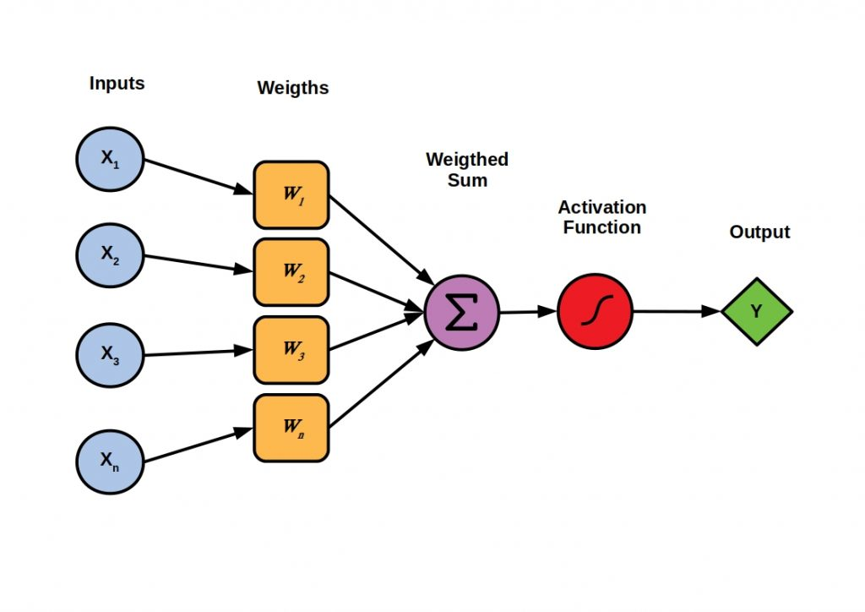
Deep Learning - Perceptron
Neuron
Perceptron motive from Neuron
Aggregate input to make output
Weighted Sum
Activation
Non-linear activation
https://velog.io/@tobe-honest/%EB%8B%A4%EC%B8%B5-%ED%8D%BC%EC%85%89%ED%8A%B8%EB%A1%A0Multi-layer-Perceptron-MLP

Slide 29
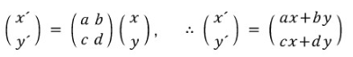
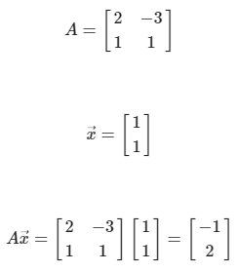
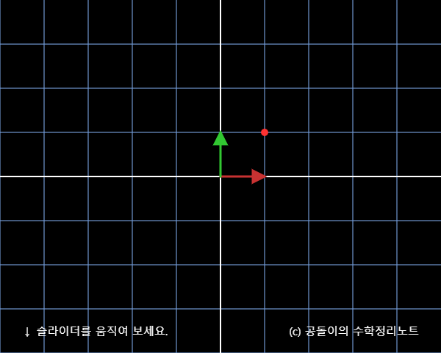
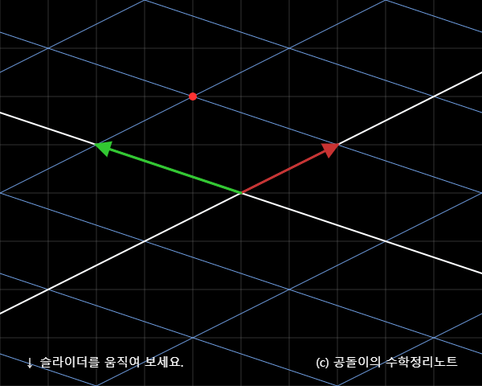
Deep Learning – Linear Transformation
Linear Combination
Linear Transformation

Slide 30
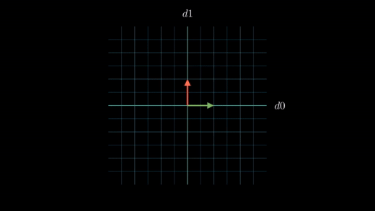
Deep Learning – Linear Transformation
Linear Combination
Linear Transformation
https://towardsdatascience.com/visualizing-the-mlp-a-composition-of-transformations-dec1c62d4eea

Slide 31
Deep Learning – Affine Transformation
Linear Combination
Linear Transformation with bias
= Affine Transformation
b
Wb
https://towardsdatascience.com/visualizing-the-mlp-a-composition-of-transformations-dec1c62d4eea

Slide 32
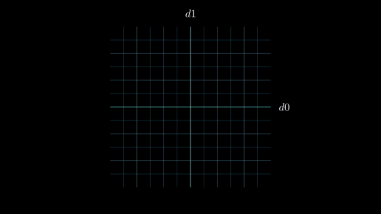
Deep Learning – Affine Transformation
Linear Combination
Linear Transformation with bias
= Affine Transformation
b
Wb
https://towardsdatascience.com/visualizing-the-mlp-a-composition-of-transformations-dec1c62d4eea

Slide 33
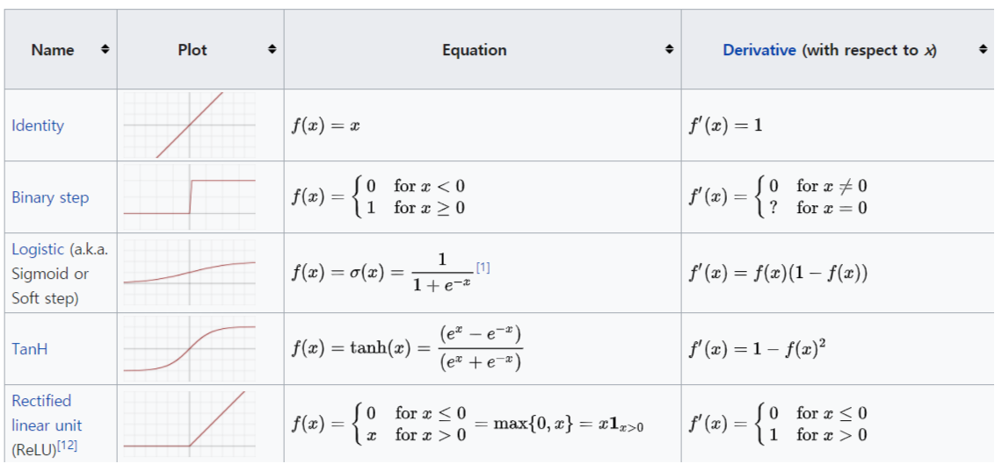
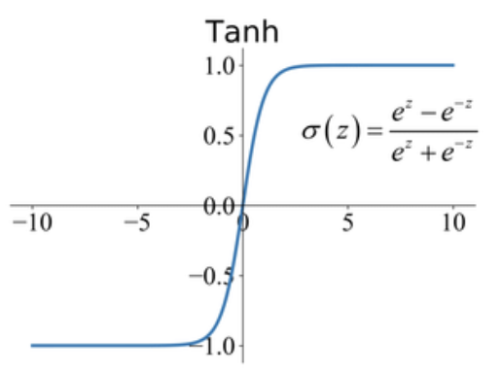
Deep Learning – Non-linear Activation
Affine Transformation + Activation
Activation function with non-linear
e.g. Tanh
b
Wb
https://towardsdatascience.com/visualizing-the-mlp-a-composition-of-transformations-dec1c62d4eea

Slide 34
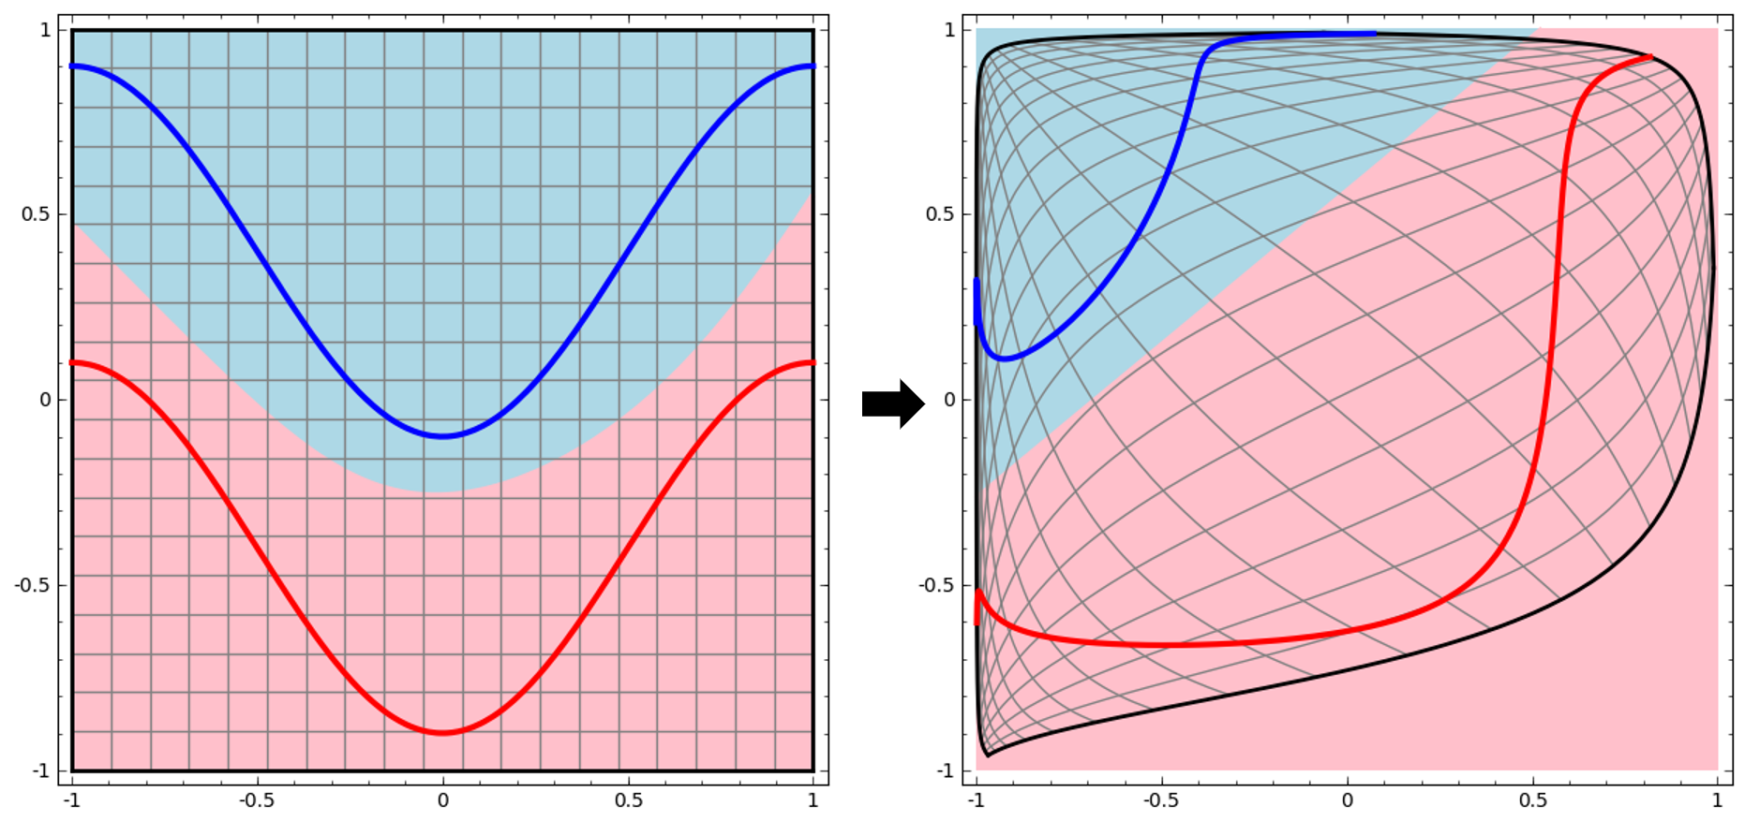
Deep Learning – Non-linear Activation
Affine Transformation + Activation
Activation function with non-linear
e.g. Tanh
b
Wb
https://towardsdatascience.com/visualizing-the-mlp-a-composition-of-transformations-dec1c62d4eea

Slide 35
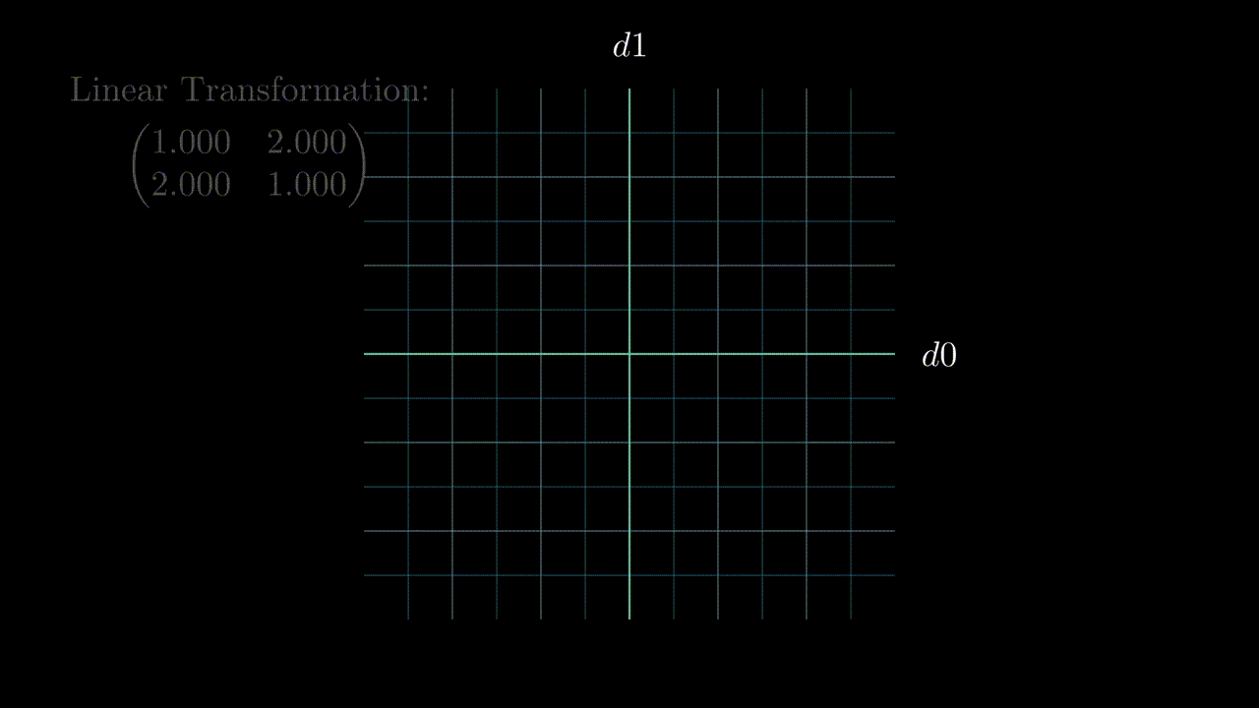
https://velog.io/@tobe-honest/%EB%8B%A4%EC%B8%B5-%ED%8D%BC%EC%85%89%ED%8A%B8%EB%A1%A0Multi-layer-Perceptron-MLP
Linear Transformation
Affine Transformation + Activation
Activation function with non-linear
b
Wb
https://towardsdatascience.com/visualizing-the-mlp-a-composition-of-transformations-dec1c62d4eea

Slide 36
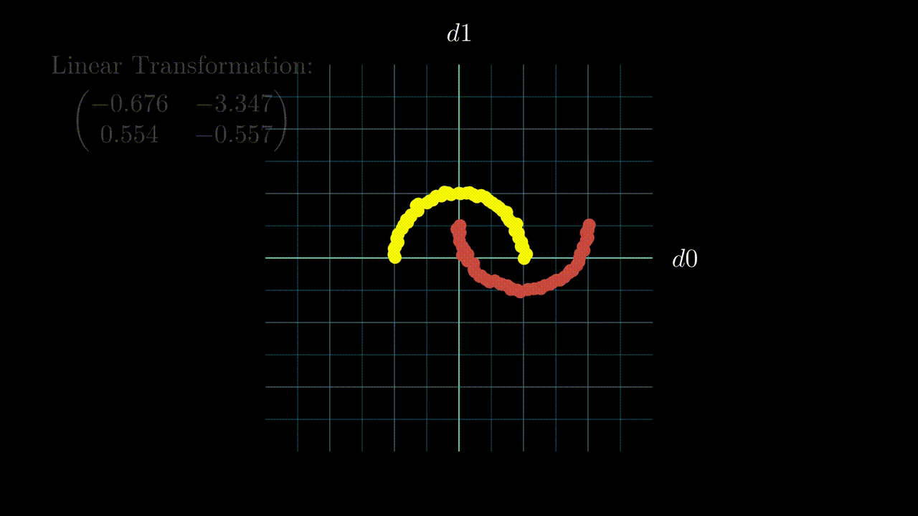
https://velog.io/@tobe-honest/%EB%8B%A4%EC%B8%B5-%ED%8D%BC%EC%85%89%ED%8A%B8%EB%A1%A0Multi-layer-Perceptron-MLP
Linear Transformation
Affine Transformation + Activation
Activation function with non-linear
b
Wb
https://towardsdatascience.com/visualizing-the-mlp-a-composition-of-transformations-dec1c62d4eea

Slide 37
Deep Learning
A part of Machine Learning
Artificial Neural Network (== MLP)
Multiple hidden layers → Deep Neural Network (DNN)
Key to Representation Learning
Learning representation of raw data
For computer to process specific task
Simple representation to complex concepts

Slide 38
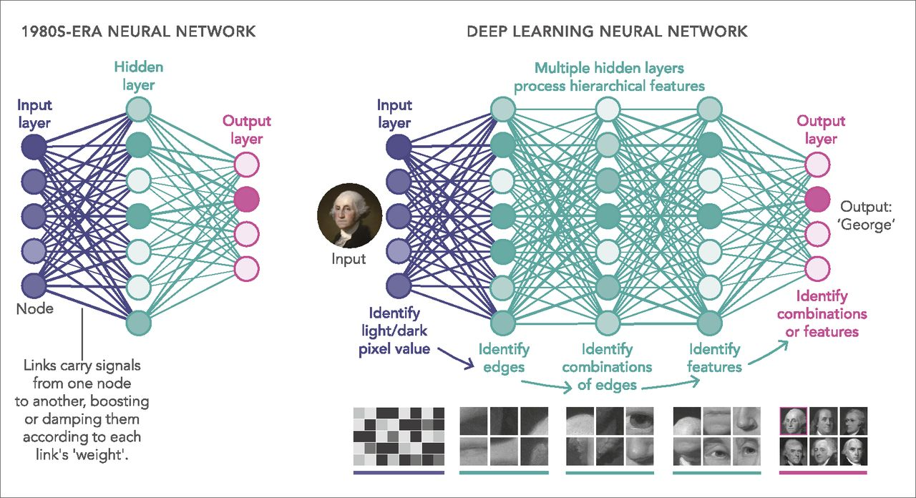
Deep Learning
A part of Machine Learning
Artificial Neural Network (== MLP)
Multiple hidden layers → Deep Neural Network (DNN)
Key to Representation Learning
Learning representation of raw data
For computer to process specific task
Simple representation to complex concepts
https://www.pnas.org/doi/full/10.1073/pnas.1821594116

Slide 39
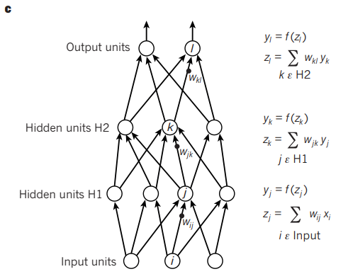
Deep Learning – Feed Forward
Overlapping layers to represent hierarchy of features
Find abstract features
https://www.pnas.org/doi/full/10.1073/pnas.1821594116

Slide 40
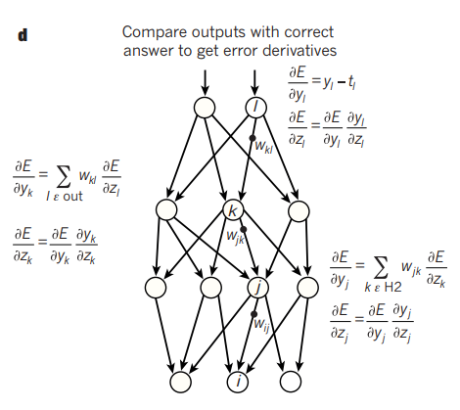
Deep Learning – Error Backpropagation
Error Backpropagation
Chain Rule
https://www.pnas.org/doi/full/10.1073/pnas.1821594116

Slide 41
Deep Learning – Solve dilemma
Insensitive to irrelevant variations
Sensitive to minute details
By general-purpose learning procedure

Slide 42
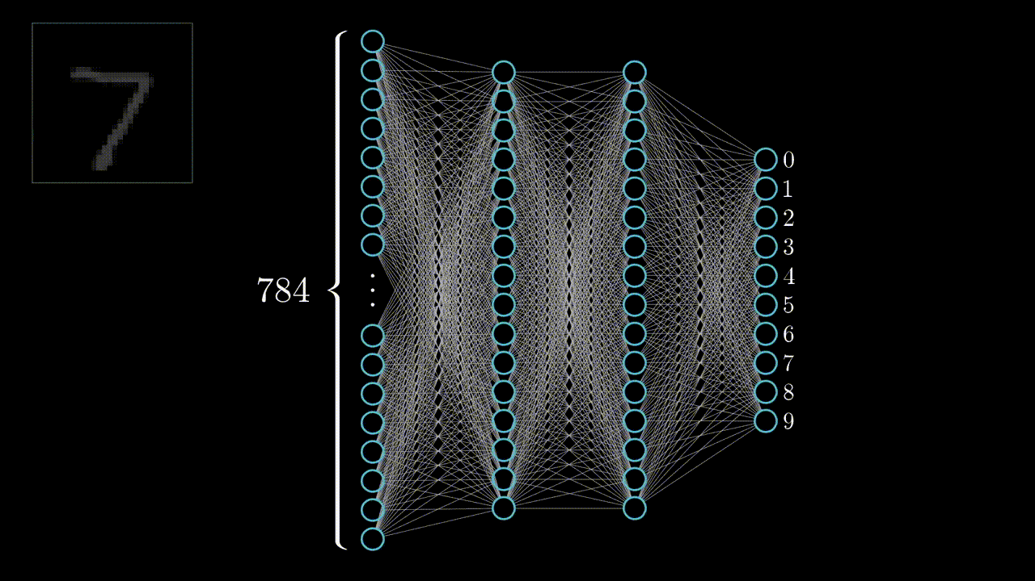
Deep Learning – Solve dilemma
Insensitive to irrelevant variations
Sensitive to minute details
By general-purpose learning procedure
https://youtu.be/aircAruvnKk

Slide 43
Convnet
Convnets
Designed to process data in forms of multiple arrays
1D : signals and sequences
2D : images and audio spectrograms
3D : video or volumetric images

Slide 44
Convnet
Problems of DNN == Motivations of ConvNet
Every output unit interacts with every input unit
Small features like edges occupy only tens or hundreds of pixels
Local pixels are highly correlated
Each element of the weight matrix is used exactly once
= learning a separate set of parameters for every location

Slide 45

Convnet
Problems of DNN == Motivations of ConvNet
Every output unit interacts with every input unit
Small features like edges occupy only tens or hundreds of pixels
Local pixels are highly correlated
Each element of the weight matrix is used exactly once
= learning a separate set of parameters for every location

Slide 46
Convnet
Problems of DNN == Motivations of ConvNet
Every output unit interacts with every input unit
Small features like edges occupy only tens or hundreds of pixels
Local pixels are highly correlated
Each element of the weight matrix is used exactly once
= learning a separate set of parameters for every location

Slide 47
Convnet
Problems of DNN == Motivations of ConvNet
Every output unit interacts with every input unit
Small features like edges occupy only tens or hundreds of pixels
Local pixels are highly correlated
Each element of the weight matrix is used exactly once
= learning a separate set of parameters for every location

Slide 48
Convnet
Problems of DNN == Motivations of ConvNet
Every output unit interacts with every input unit
Small features like edges occupy only tens or hundreds of pixels
Local pixels are highly correlated
→ Sparse Interaction = Local Receptive Fields = Small kernels
Each element of the weight matrix is used exactly once
= learning a separate set of parameters for every location
→ Parameter Sharing = Shared Weights

Slide 49
Convnet
Ideas of Convolution
Every output unit interacts with every input unit
Small features like edges occupy only tens or hundreds of pixels
Local pixels are highly correlated
→ Sparse Interaction = Local Receptive Fields = Small kernels
Each element of the weight matrix is used exactly once
= learning a separate set of parameters for every location
→ Parameter Sharing = Shared Weights

Slide 50
Convnet - Sparse Interaction
Kernels are smaller than input
→ Less memory usage
→ Less computation

Slide 51
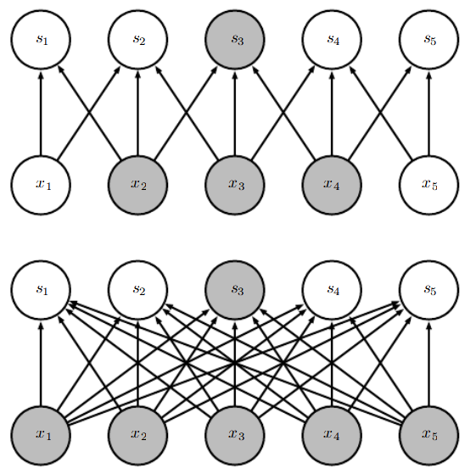
Convnet - Sparse Interaction
Sparse Interaction
Kernels are smaller than input
→ Less memory usage
→ Less computation
Deep Neural Network

Slide 52
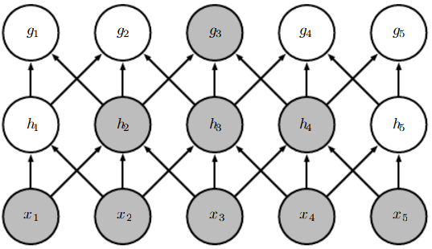
Convnet - Sparse Interaction
Kernels are smaller than input
→ Less memory usage
→ Less computation
Sparse Interaction in Deeper Layers

Slide 53
Convnet – Parameter Sharing
Using same parameters for different
functions in model
→ Less parameters to save

Slide 54
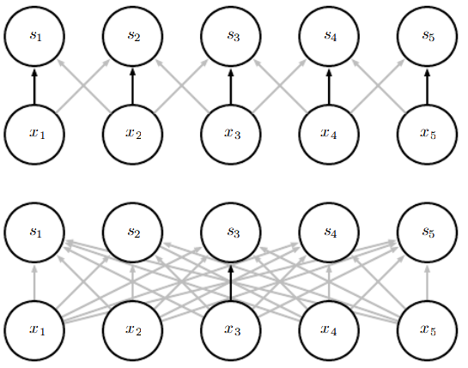
Convnet – Parameter Sharing
Using same parameters for different
functions in model
→ Less parameters to save
Parameter Sharing
Deep Neural Network

Slide 55

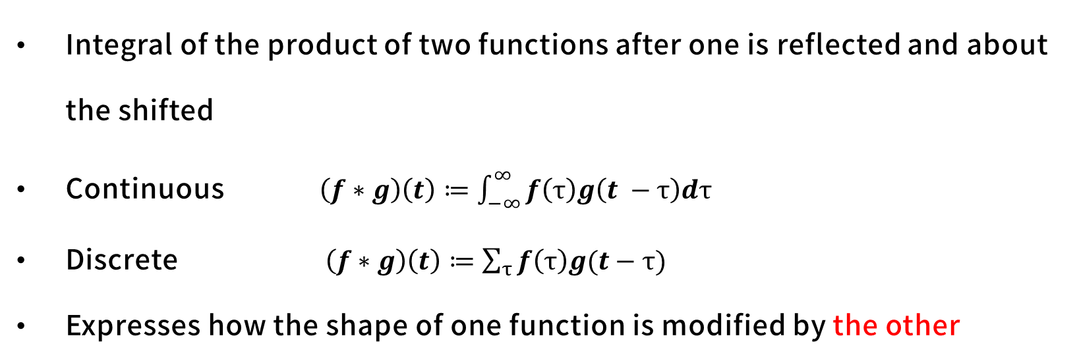
Convnet – Convolution
Integral of the product of two functions after one is reflected and about the shifted
Continuous $\left(f∗g\right)\left(t\right)≔\int_{−∞}^{∞}{f\left(τ\right)g\left(t −τ\right)dτ}$
Discrete $\left(f∗g\right)\left(t\right)≔\sum_{τ}{f\left(τ\right)g(t−τ)}$
Expresses how the shape of one function is modified by the other
Kernel (Filter)
https://commons.wikimedia.org/wiki/File:Convolution_of_spiky_function_with_box.gif

Slide 56
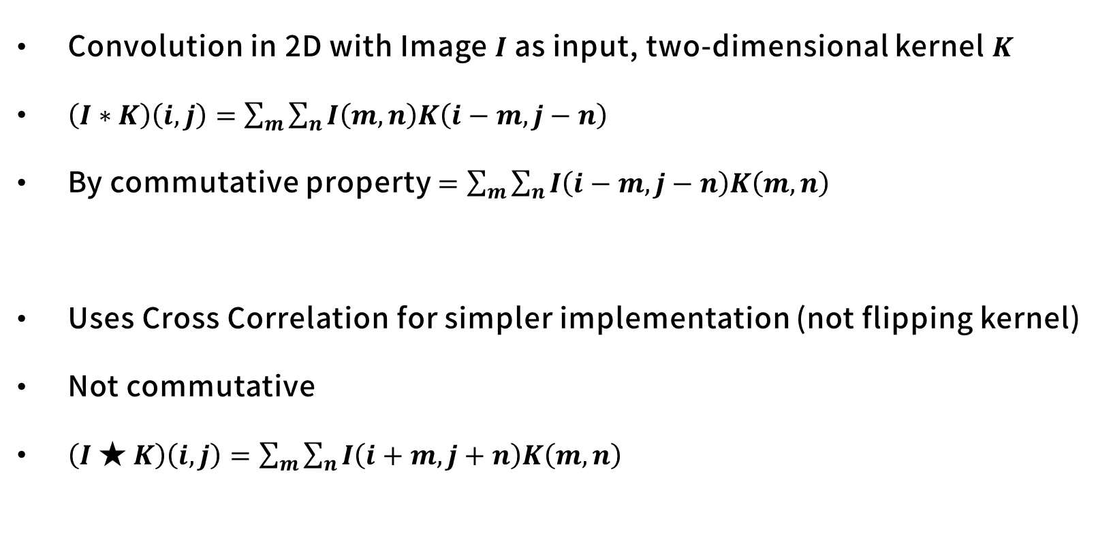
Convnet – 2D Convolution
Convolution in 2D with Image $I$ as input, two-dimensional kernel $K$
$\left(I∗K\right)\left(i, j\right)=\sum_{m}{\sum_{n}{I\left(m,n\right)K\left(i−m, j−n\right)}}$
By commutative property $=\sum_{m}{\sum_{n}{I\left(i−m,j−n\right)K\left(m, n\right) }}$
Uses Cross Correlation for simpler implementation (not flipping kernel)
Not commutative
$\left(I★K\right)\left(i, j\right)=\sum_{m}{\sum_{n}{I\left(i+m,j+n\right)K\left(m, n\right) }}$

Slide 57
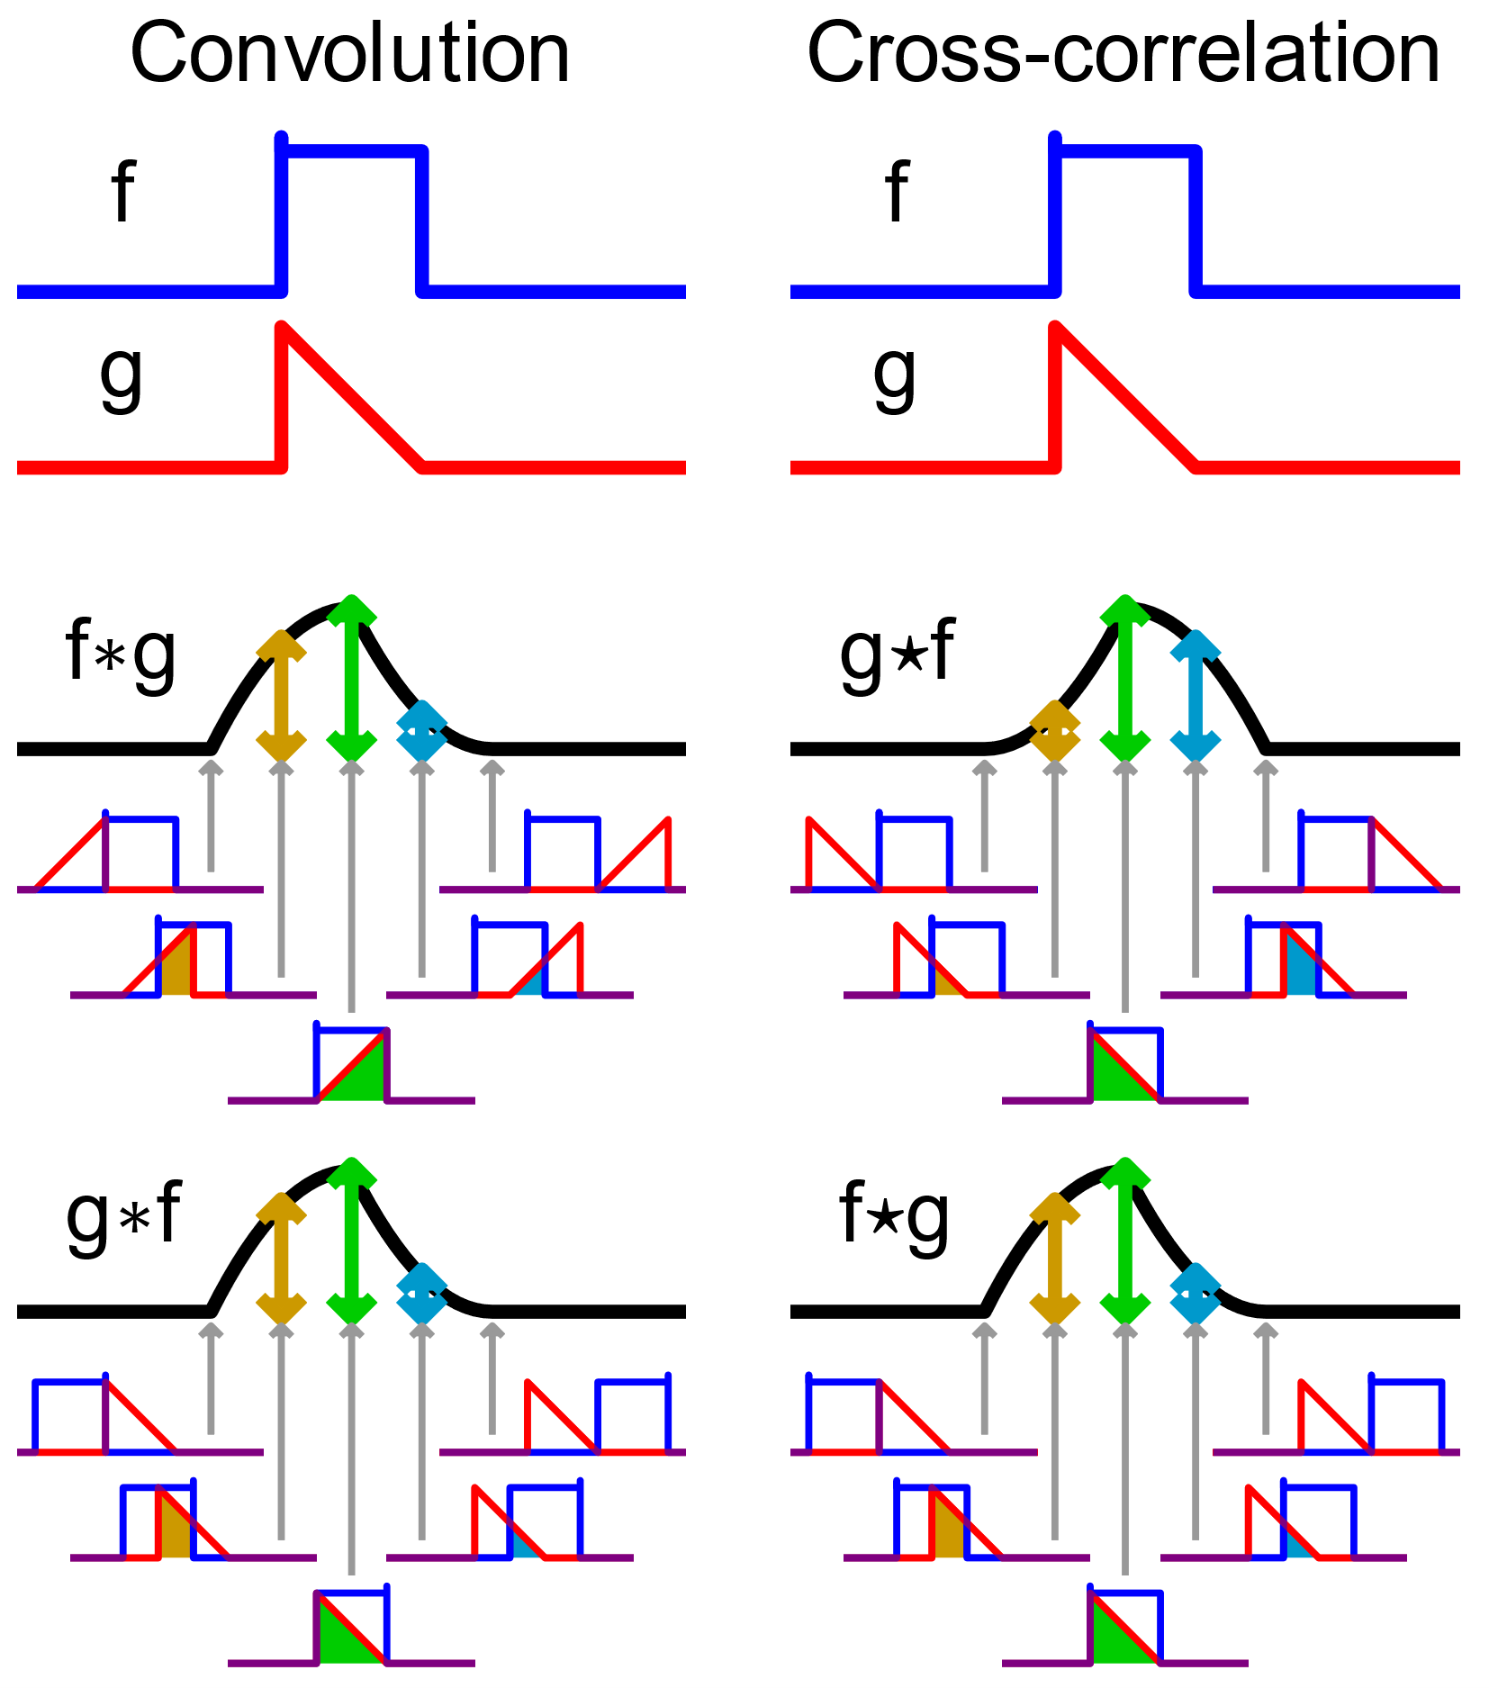
Convnet – 2D Convolution
Convolution in 2D with Image $I$ as input, two-dimensional kernel $K$
$\left(I∗K\right)\left(i, j\right)=\sum_{m}{\sum_{n}{I\left(m,n\right)K\left(i−m, j−n\right)}}$
By commutative property $=\sum_{m}{\sum_{n}{I\left(i−m,j−n\right)K\left(m, n\right) }}$
Uses Cross Correlation for simpler implementation (not flipping kernel)
Not commutative
$\left(I★K\right)\left(i, j\right)=\sum_{m}{\sum_{n}{I\left(i+m,j+n\right)K\left(m, n\right) }}$

Slide 58
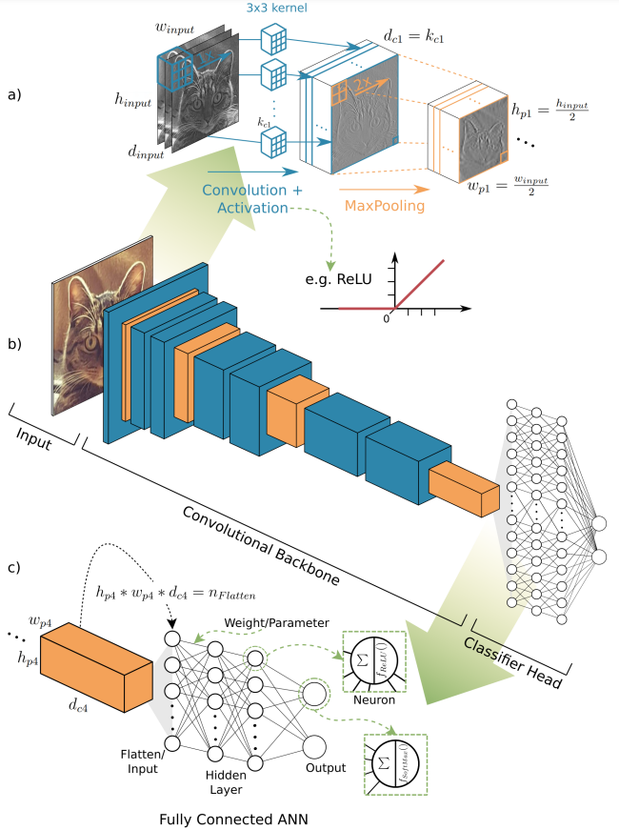
Convnet - Structure
Convolution > Activation > Pooling
Convolution
Activation : nonlinear activation function
Pooling :
Summary statistics of output
ex) Max Pooling -> getting maximum
output within a rectangular neighbor
Translation invariance
<Object Detection and Image Segmentation with Deep Learning on Earth Observation Data: A Review-Part I: Evolution and Recent Trends> Thorsten Hoeser, Claudia Kuenzer

Slide 59
Convnet - Structure
Convolution > Activation > Pooling
Convolution
Activation : nonlinear activation function
Pooling :
Summary statistics of output
ex) Max Pooling -> getting maximum
output within a rectangular neighbor
Translation invariance
<Object Detection and Image Segmentation with Deep Learning on Earth Observation Data: A Review-Part I: Evolution and Recent Trends> Thorsten Hoeser, Claudia Kuenzer

Slide 60


Convnet - Structure
Convolution > Activation > Pooling
Convolution
Activation : nonlinear activation function
Pooling :
Summary statistics of output
ex) Max Pooling -> getting maximum
output within a rectangular neighbor
Translation invariance

Slide 61
Convnet - Structure
Convolution > Activation > Pooling
Convolution
Activation : nonlinear activation function
Pooling :
Summary statistics of output
ex) Max Pooling -> getting maximum
output within a rectangular neighbor
Translation invariance
<Object Detection and Image Segmentation with Deep Learning on Earth Observation Data: A Review-Part I: Evolution and Recent Trends> Thorsten Hoeser, Claudia Kuenzer

Slide 62
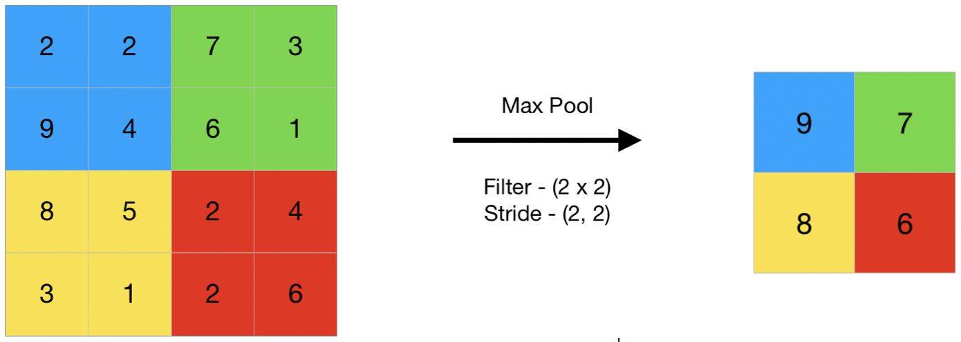
Convnet - Structure
Convolution > Activation > Pooling
Convolution
Activation : nonlinear activation function
Pooling :
Summary statistics of output
ex) Max Pooling -> getting maximum
output within a rectangular neighbor
Translation invariance

Slide 63
Convnet - Structure
Convolution > Activation > Pooling
Convolution
Activation : nonlinear activation function
Pooling :
Summary statistics of output
ex) Max Pooling -> getting maximum
output within a rectangular neighbor
Invariance to small shifts and distortions

Slide 64
Convnet - Structure
Convolution > Activation > Pooling
Convolution
Activation : nonlinear activation function
Pooling :
Summary statistics of output
ex) Max Pooling -> getting maximum
output within a rectangular neighbor
Translation invariance
<Object Detection and Image Segmentation with Deep Learning on Earth Observation Data: A Review-Part I: Evolution and Recent Trends> Thorsten Hoeser, Claudia Kuenzer

Slide 65
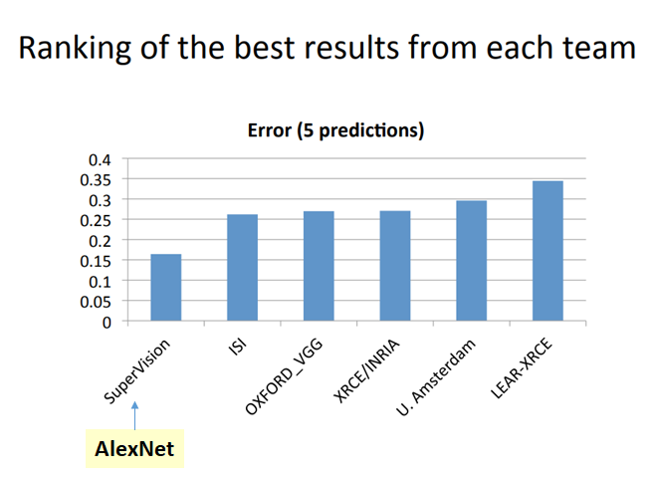
Convnet - AlexNet
ImageNet Competition 2012
Winner
Efficient use of GPUs
ReLU
Dropout
Data Augmentation
https://medium.com/coinmonks/paper-review-of-alexnet-caffenet-winner-in-ilsvrc-2012-image-classification-b93598314160

Slide 66
Distributed Representations
Distribution Hypothesis
Underlying data-generating distribution has as appropriate componential structure
Words in similar position similar semantic
You shall know a word by the company it keeps. - J.R. Firth (1957)
Find target word by its companies
Elements are not mutually exclusive & Variations

Slide 67
Distributed Representations – Local representation
Local representation (Discrete Representation)
Consider word it self in a sentence
One-hot Encoding (Sparse Representation)

Slide 68
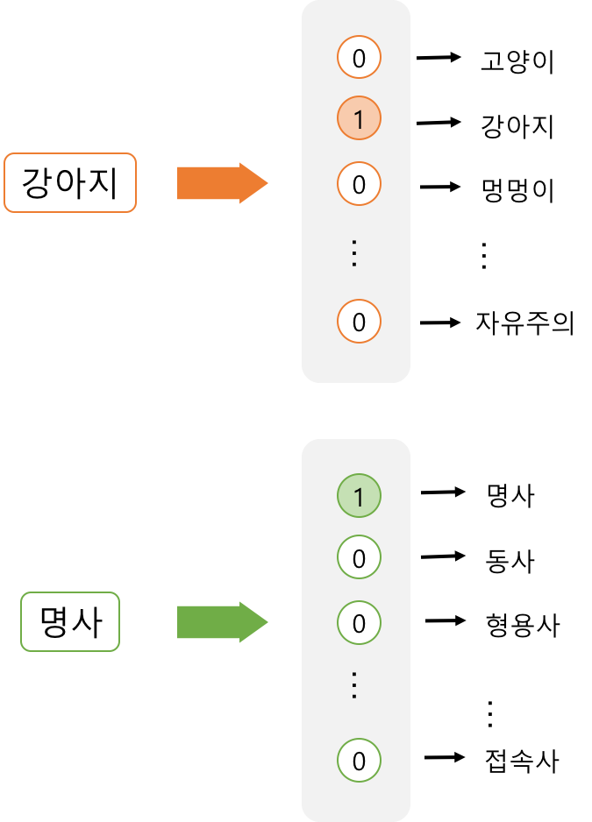
Distributed Representations – One-hot Encoding
Local representation (Discrete Representation)
Consider word it self in a sentence
One-hot Encoding (Sparse Representation)
https://dreamgonfly.github.io/blog/word2vec-explained/

Slide 69
Distributed Representations – One-hot Encoding
Local representation (Discrete Representation)
Consider word it self in a sentence
One-hot Encoding (Sparse Representation)
Cannot compute cosine similarity
High dimension
https://dreamgonfly.github.io/blog/word2vec-explained/

Slide 70
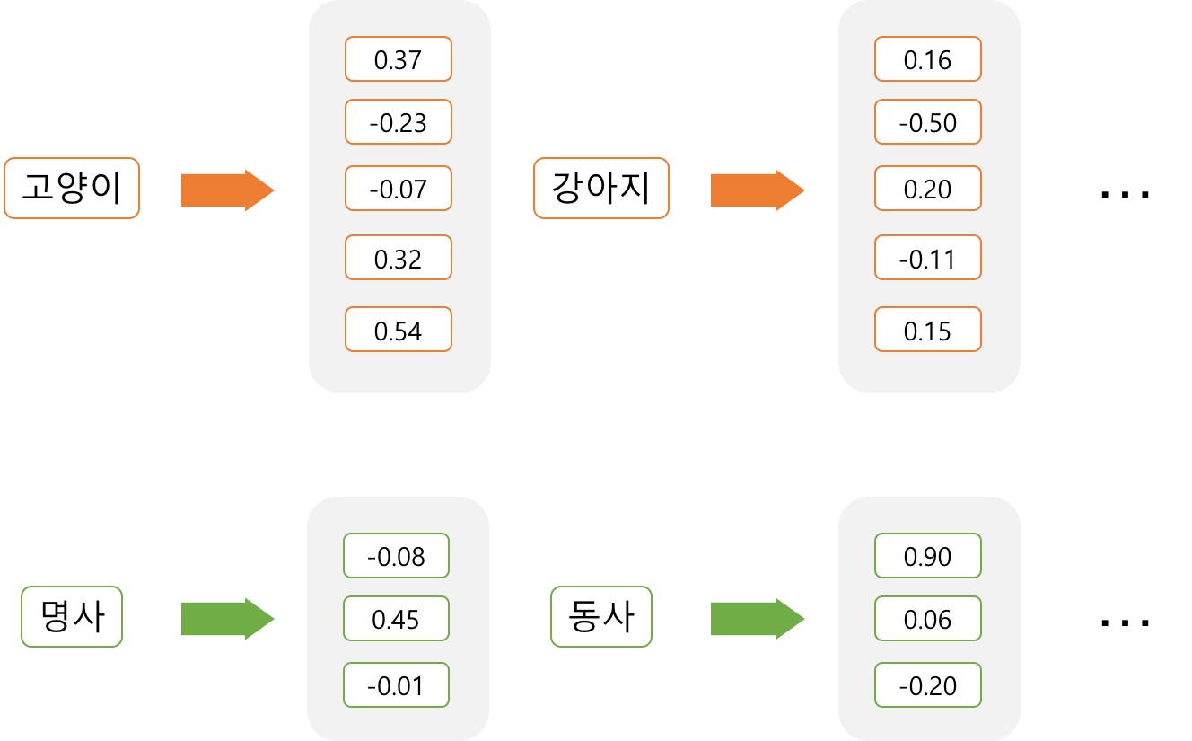
Distributed Representations
Distributed representation ( ⊂ Continuous Representation)
= Dense Representation
Vector embedding
https://dreamgonfly.github.io/blog/word2vec-explained/

Slide 71

Distributed Representations
Distributed representation ( ⊂ Continuous Representation)
= Dense Representation
Vector embedding → Word2Vec, …

Slide 72
Distributed Representations
Distributed representation ( ⊂ Continuous Representation)
= Dense Representation
Vector embedding → Word2Vec, …
Less dimension
Discover semantic features that are not explicitly present by neural network

Slide 73
Distributed Representations
Distributed representation ( ⊂ Continuous Representation)
= Dense Representation
Vector embedding → Word2Vec, …
Less dimension
Discover semantic features that are not explicitly present by neural network
https://word2vec.kr/search/?query=%ED%95%9C%EA%B5%AD-%EC%84%9C%EC%9A%B8%2B%EB%8F%84%EC%BF%84

Slide 74

RNN
Recurrent Neural Network
Process an input sequence one element at a time
Maintain hidden state vector (W) → memory
Dynamic = Variable length of sequence of inputs
Difficult to train to store information for very long
= Vanishing gradient problem of RNN

Slide 75

RNN - LSTM
LSTM (Long Short-Term Memory)
Deal with vanishing gradient problem of RNN
RNN with both long-term memory
and short-term memory
https://en.wikipedia.org/wiki/Long_short-term_memory#/media/File:LSTM_Cell.svg

Slide 76
Thank
You
감사합니다.

